Slide 1
Computation-empowered Chemoproteomics
Jing Yang
Guangzhou National Laboratory
National Center for Protein Sciences - Beijing
Aug 31, 2023
CNCP2023@Beijing

Slide 2

Chemoproteomics
Chemoselective probes
MS-based
Proteomics
Why do we need chemoproteomics？
How to develop chemoproteomic methods？
So what chemoproteomic method can do？

Slide 3
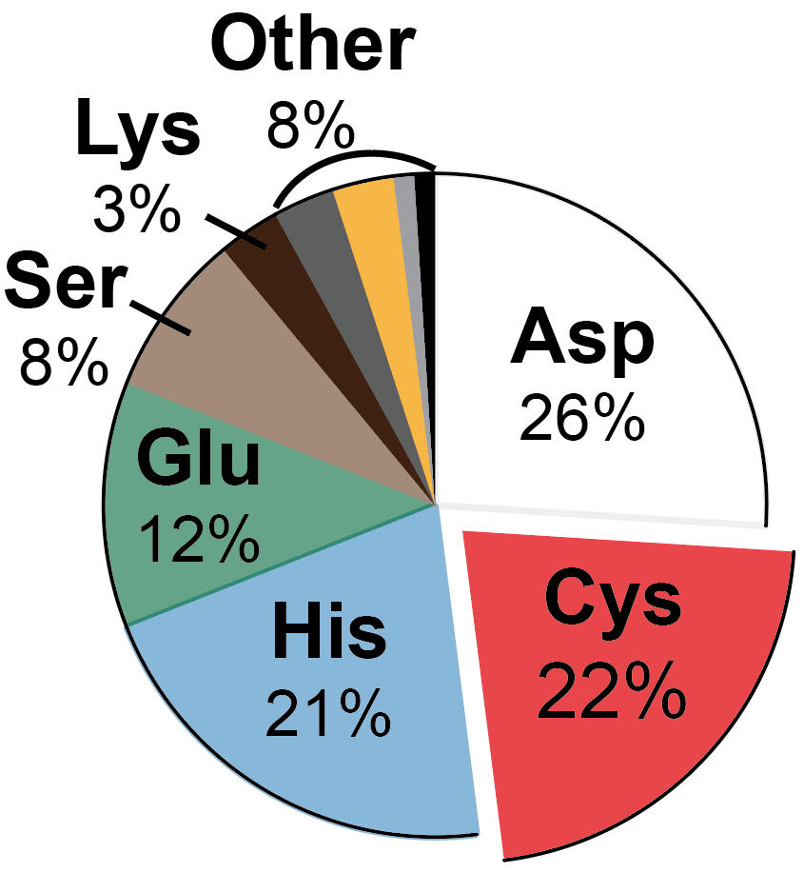
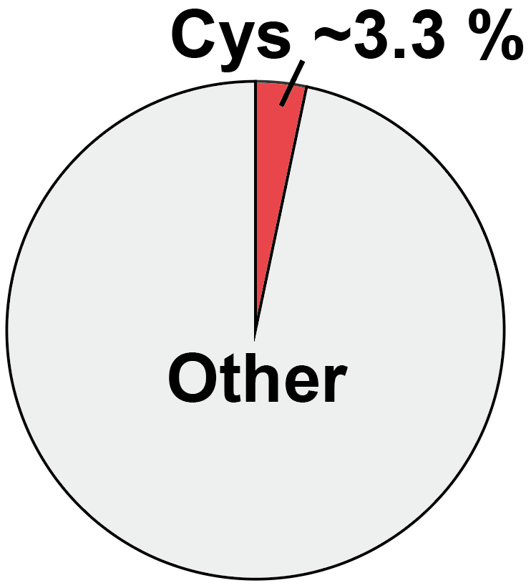
A major theme of our research:
The cysteinome
% In the human proteome
% All sites with Uniprot function annotation

Slide 4
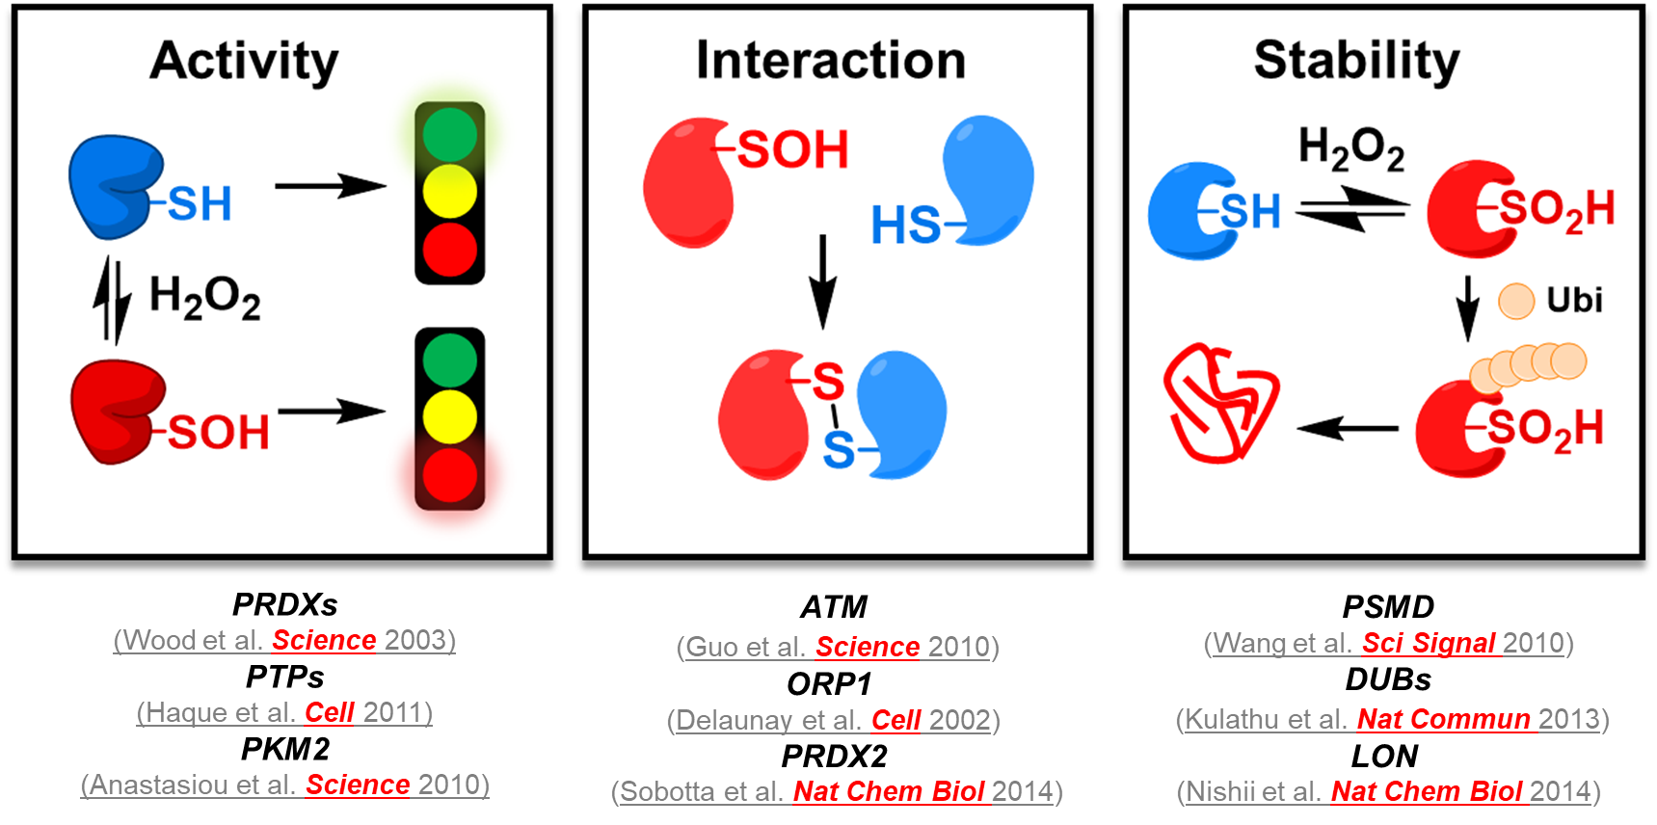
Redox changes on cysteine residues
reversibly alter protein functions

Slide 5
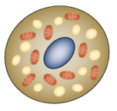
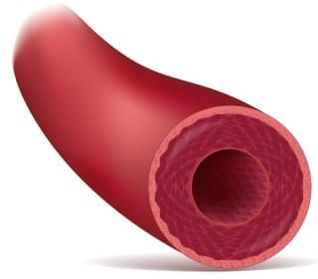
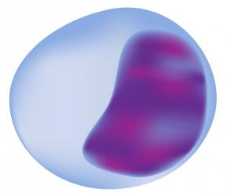

Cys-mediated redox regulation in physiology
Adipose thermogenesis
Circadian clock
Vascular tone
Chouchani ET, et al.
Nature, 2016
O’Neill JS, et al.
Nature, 2011
Chen CA, et al.
Nature, 2010
Leukocyte recruitment
Neuronal excitation
DNA damage repairing
Yoo SK, et al.
Nature, 2010
Ruppersberg JP, et al.
Nature, 1991
Guo Z, et al.
Science, 2010

Slide 6
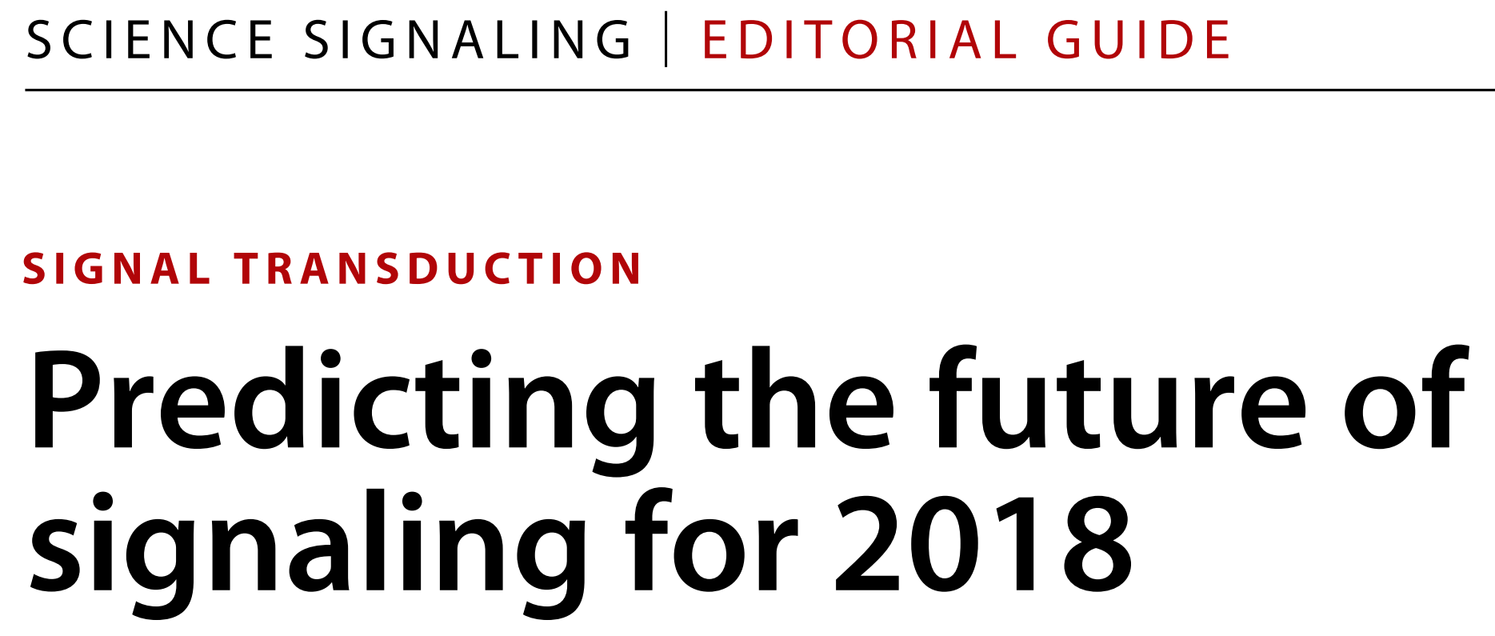
Fundamental questions in redox biology
Whether or how does the cysteine-mediated redox change affect protein function and redox signaling in physiology and pathology?
  “The difficulty in this field is largely a technical one”
  EIC, Michael B. Yaffe

Slide 7
Cysteine-mediated redox network
Oxidation
Reduction
Disulfide
Thiol
Sulfenic acid
Sulfinic acid
  Challenge：Chemical diversity and lability

Slide 8
Carbon nucleophiles for SOH labeling
Nucleophilic
carbon
DCP-Bio*
环己二酮 (DMD)*
DAz-2*
1974
2007
2008
2009
2011
DYn-2*
DMD: J Biol Chem. 1974
DCP-Bio: Bioconjug Chem. 2007
Anti-CysDMD: PNAS. 2009
DYn-2: Nat Chem Biol. 2011
Anti-CysDMD*
*: Commercialized

Slide 9
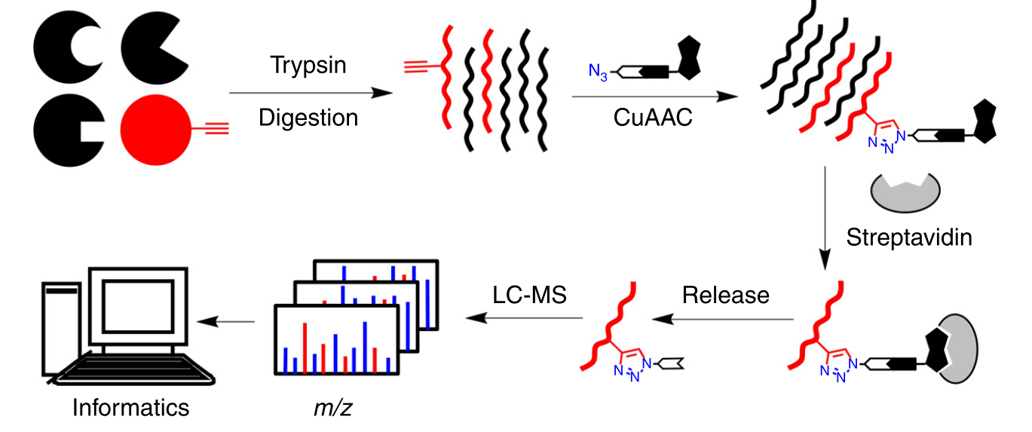
Peptide/Site-centric Chemoproteomics
Nat Protoc, 2015

Slide 10
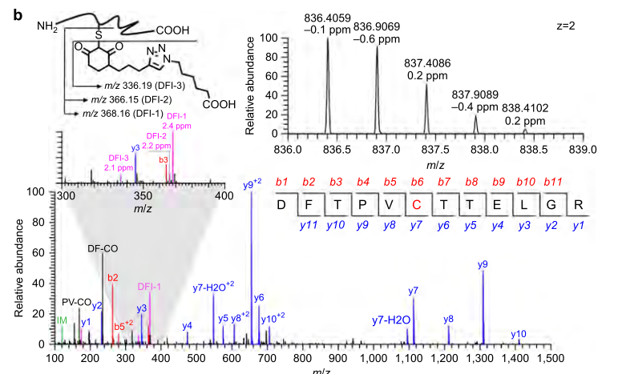
Representative MS/MS spectrum of a probe-modified peptide
Nat Commun, 2014

Slide 11
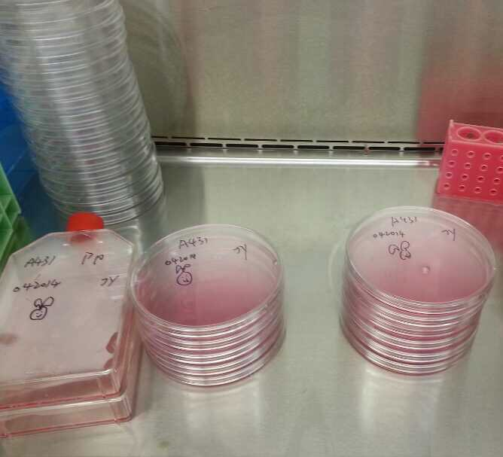
Better probes are warrented
DYn-2-based chemoproteomic profiling of protein sulfenic acids
300~1000 sites
30-40mg/Exp
~5,000 $/Exp

Slide 12
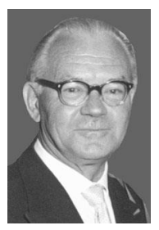
Wittig reagents
  Carbon nucleophile
A widespread approach for the preparation of alkenes through the use of Triphenylphosphonium Ylides (Wittig reagents)
Wittig reagents holds a carbon anion with strong nucleophilicity
Georg Wittig (1897-1987)
Wittig Reaction (1954)
Nobel Prize in Chemistry (1979)

Slide 13
Biocompatibility of Wittig reagents
The nucleophilicity of Wittig reagents can be modulated by Anion Stabilizing Group (ASG)
More stable ylides to perform reactions in physiological conditions
Can Wittig reagents be repurposed as the reaction partner to Cys-SOH?
J Org Chem, 2007, 72: 5244

Slide 14
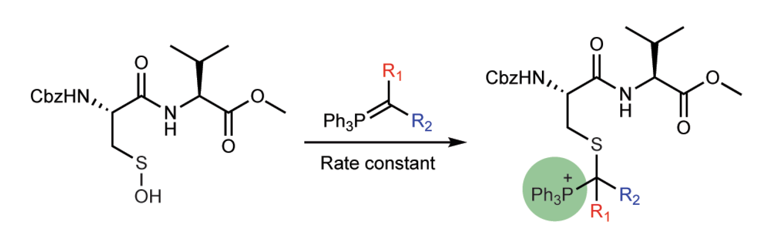
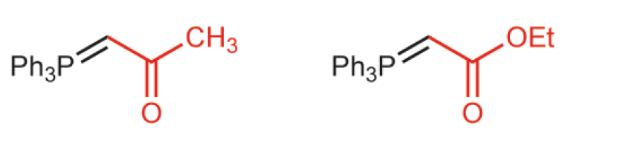
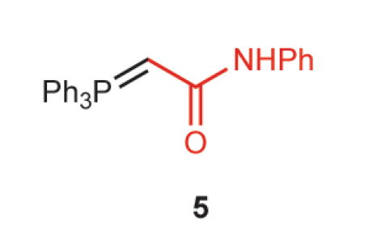
Reactivity of Wittig reagents toward SOH
SOH model
Ketone
Ester
Amide
Yield of Adduct: 93%
87%
69%
Wittig derivatives can form stable adducts with SOH in quantitative yields
史云龙 等. Nat Chem, 2021

Slide 15
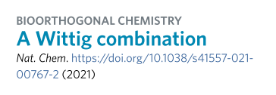
The end of the story？
WYneC
WYneO
WYneN

Slide 16
Traditional approaches for probe evaluation

Slide 17
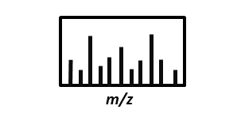


How to assess the proteome-wide selectivity of probes?
Challenges：
The enormous chemical space in biological systems
Personal experiences and biases inevitably have an influence on assessments
MS/MS
Restricted search for targeted Mods
S
Manual evaluation

Slide 18

Switching to Open Search
-100
1000
-100
1000
Mass shifts
Mass shifts
Restricted Search: Allow a subset of mass shifts (e.g., expected modifications derived from a probe)
Open Search: Allow peptides with any mass shifts (both expected and unexpected modifications) to be recovered
Open search alone can NOT distinguish probe modifications from endogenous PTMs

Slide 19
An isotope-coding approach to distinguish probe modifications from endogenous PTMs
孙瑞 等. Mol Cell Proteomics, 2017（Highlighted by MCP）

Slide 20
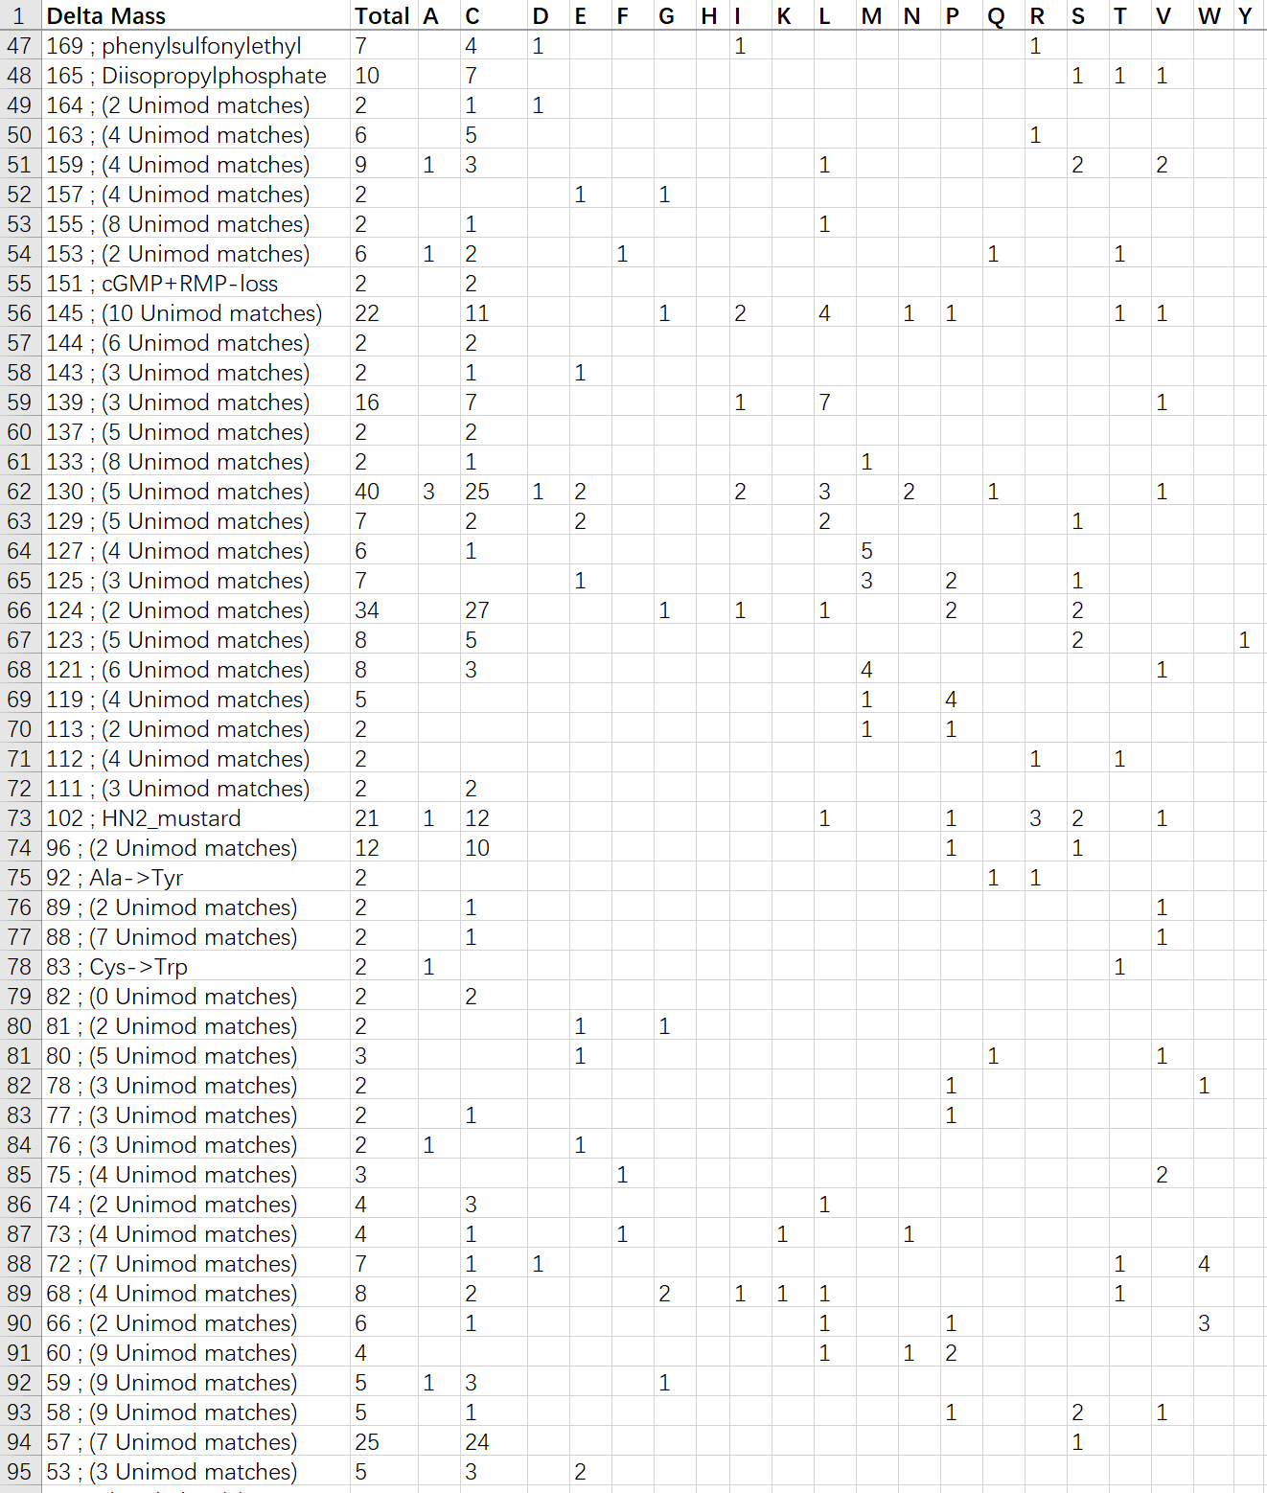
Challenges remain
Limitations of Open Search
Manual inspection required
Inaccurate mass calculation
Ambiguous site localization
Too many redundant information

Slide 21
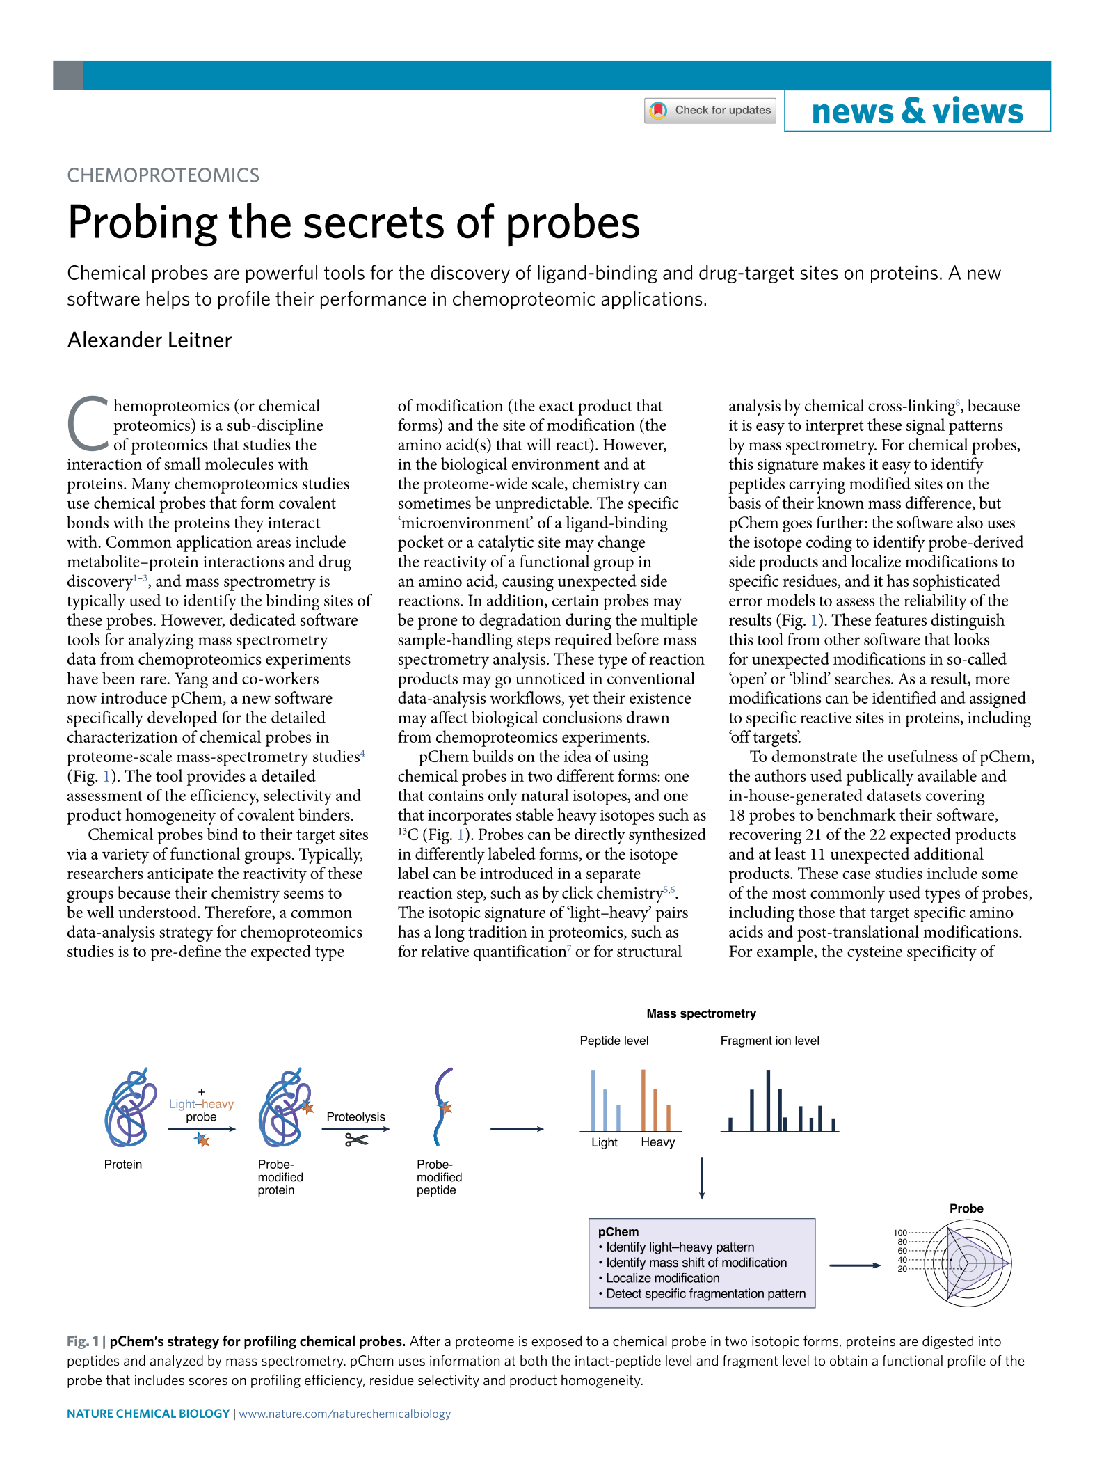
A modification-centric assessment tool for the performance of chemoproteomic probes
贺继祥/费政聪 等.
Nat Chem Biol, 2022
Highlighted by Nat Chem Biol

Slide 22
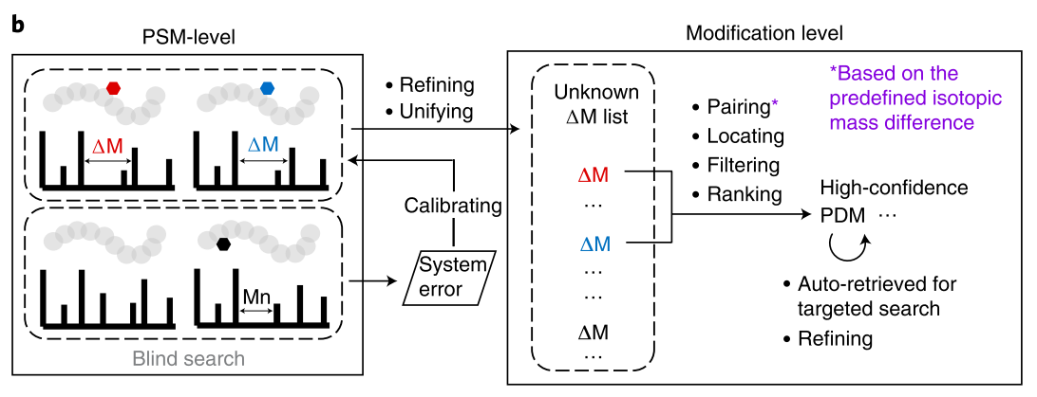
Reimagining an Open Search engine
From PSM-centric to modification-centric
Precise site localization of modifications
Accurate calculation of modification masses
Open-pFind
Nat Biotechnol
2018

Slide 23
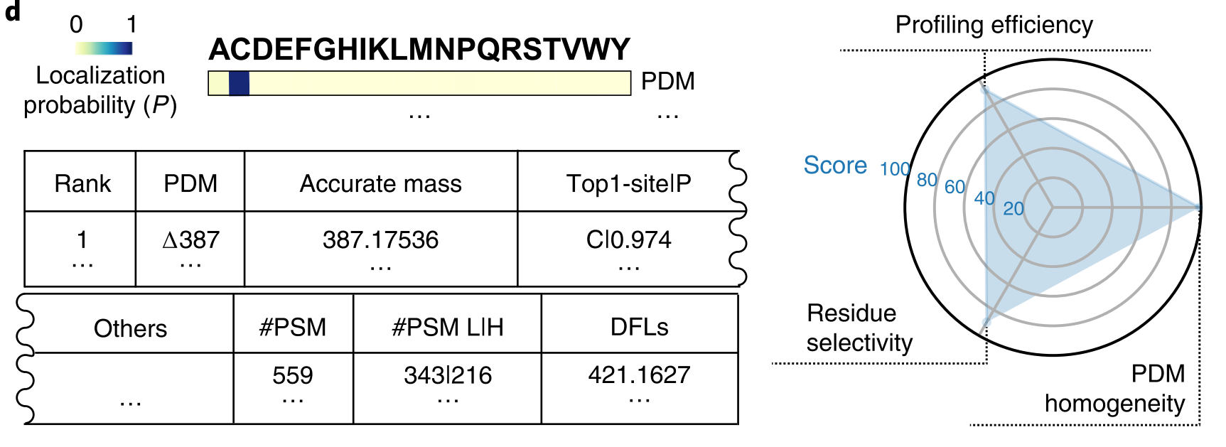
First-in-class: A fit-for-purpose assessment tool
Automatic recognition of isotope-encoded probe modifications
On-demand reporting summary and performance scoring
Installation-free and User friendly

Slide 24
Restricted search for targeted modifications
Kinetics | 196M⁻¹s⁻¹ | 140M⁻¹s⁻¹ | <10M⁻¹s⁻¹
MOD | ∆511@C | ∆513@C | ∆512@C
ID# | ~300 | ~100 | 0
WYneC
WYneO
WYneN
Lower than that can be obtained by using dimedone-based probes?!

Slide 25
TagRecon-based open search revealed unexpected probe modifications
Unexp | ∆265@C | ∆267@C | ∆252@C
ID# | >500 | >2,000 | >3,500
Theor. Mass | ∆265.1063 | ∆267.0855 | ∆252.1222
WYneC
WYneO
WYneN

Slide 26
Reanalysis by pChem
√
Theor. Mass | ∆265.1063 | ∆267.0855 | ∆252.1222
Cal. Mass | ∆265.1441 | ∆267.1213 | ∆252.1212
Error | 142 ppm | 134 ppm | -4 ppm
WYneC
WYneO
WYneN

Slide 27
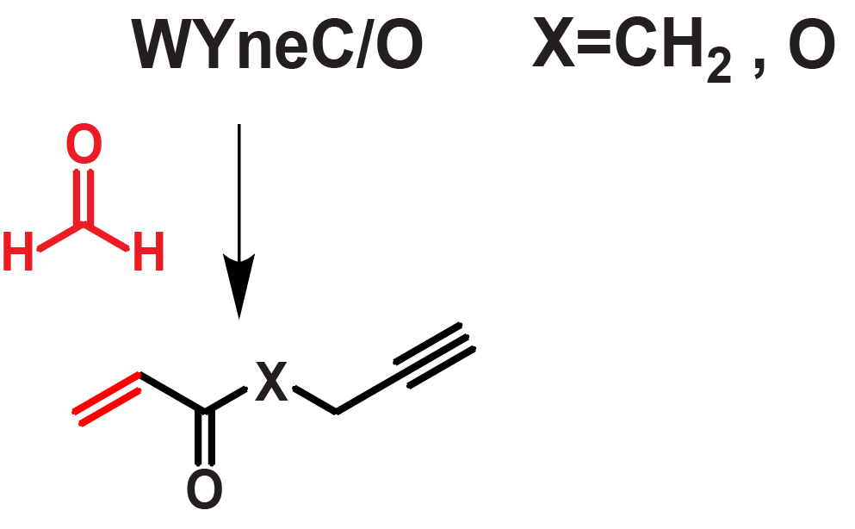
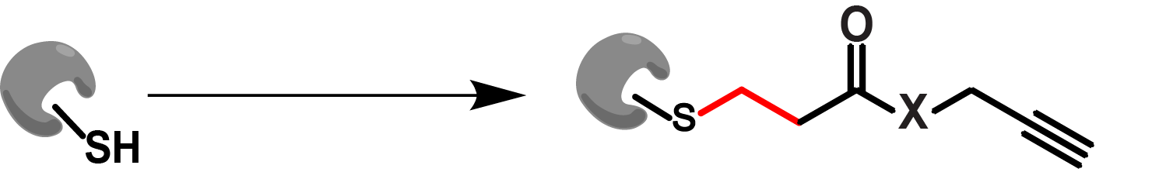
‘Secrets’ of WYneC/O
Formaldehyde
Wittig reaction
Michael
addition
WYneC/O react with endogenous aldehydes
The α,β-unsaturated ketone products react with SH rather than SOH
WYneC/O can NOT be used for SOH labeling in cells！

Slide 28
WYneN is the best-in-class SOH probe
Nat Chem Biol, 2012
J Am Chem Soc,
2017
Nat Chem,
2021
WYneN enables efficient SOH labeling in living cells

Slide 29

pChem-qualified probes for the Cys redoxome
Thiol
WYneN
Sulfenic acid
HASyne
Sulfinic acid

Slide 30
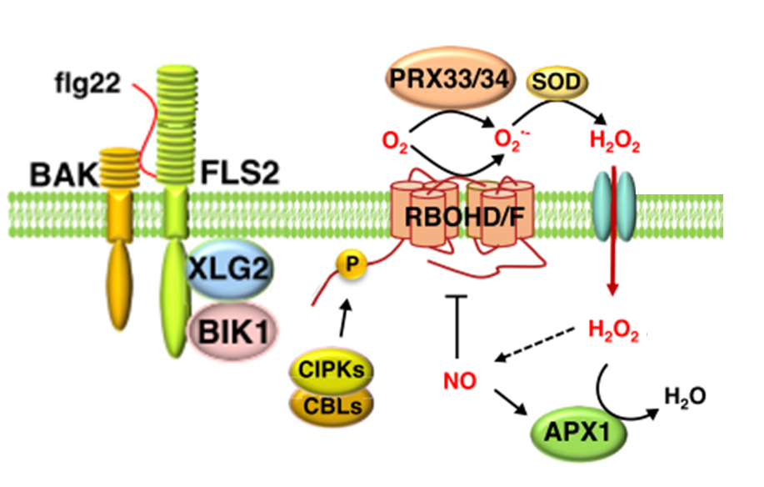
A fundamental question in plant immunity?
?
What is the sensor of H2O2 triggered by plant immune response?
Adapted from Qi J, et al. Curr Opin Plant Biol. 2017

Slide 31
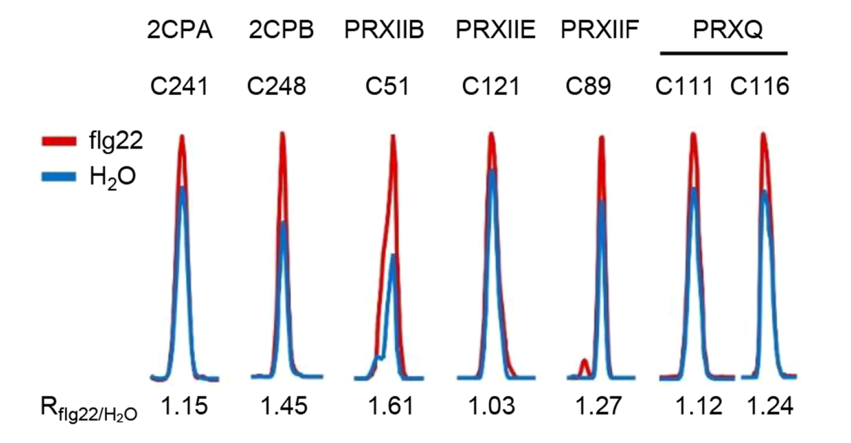
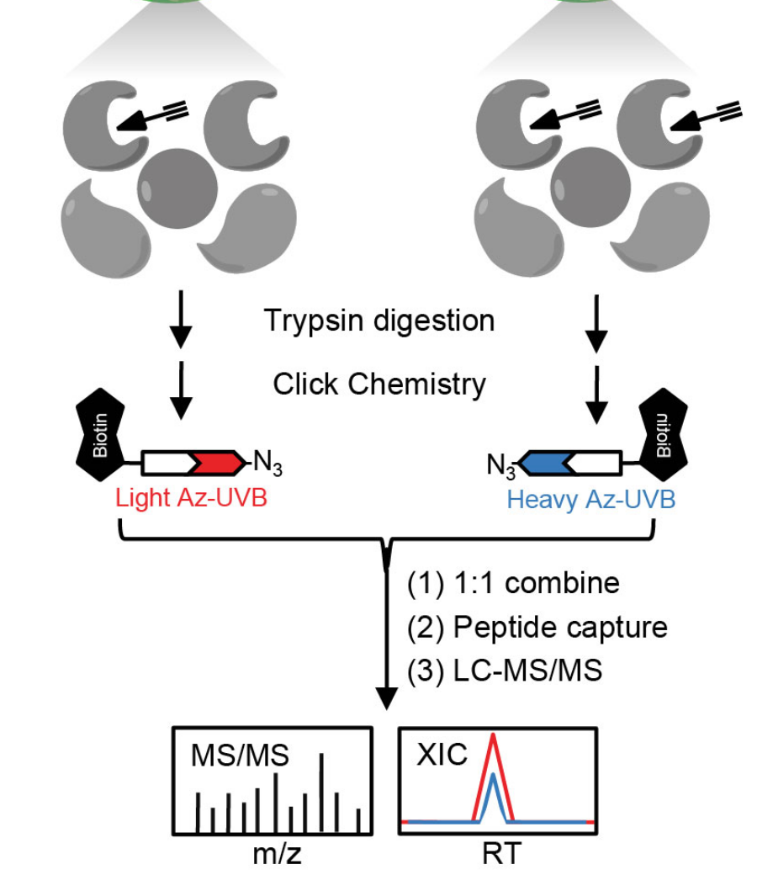
Mining for H₂O₂ sensors in plant immunity
flg22
Crl
SOH
profiling
C51 of PRXIIB is sensitive to flg22 treatment
毕国志/胡满/付玲, et al., Nat Plants, 2022

Slide 32
C51 of PRXIIB is critical for stomatal immunity
1.0
0.8
prxiib KO reverse pathogen-induced stomatal closure
WT but not the C51S mutant closes stomata after bacterial treatment
0.6
Stomatal aperture
Stomatal closure
0.4
0.2
Control
Pathogen
0
Col-0
KO
WT
C51S
KO
毕国志/胡满/付玲, et al., Nat Plants, 2022

Slide 33
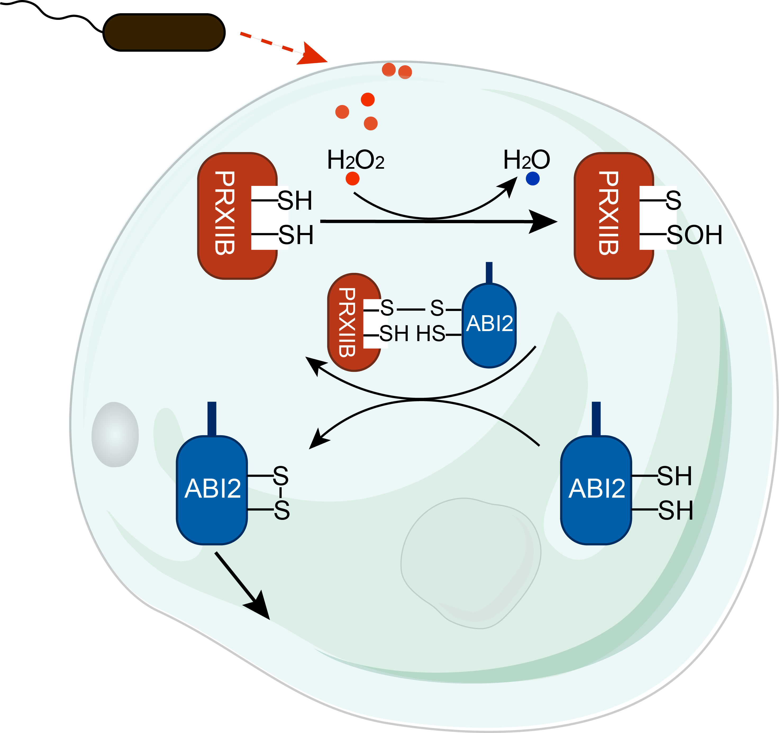
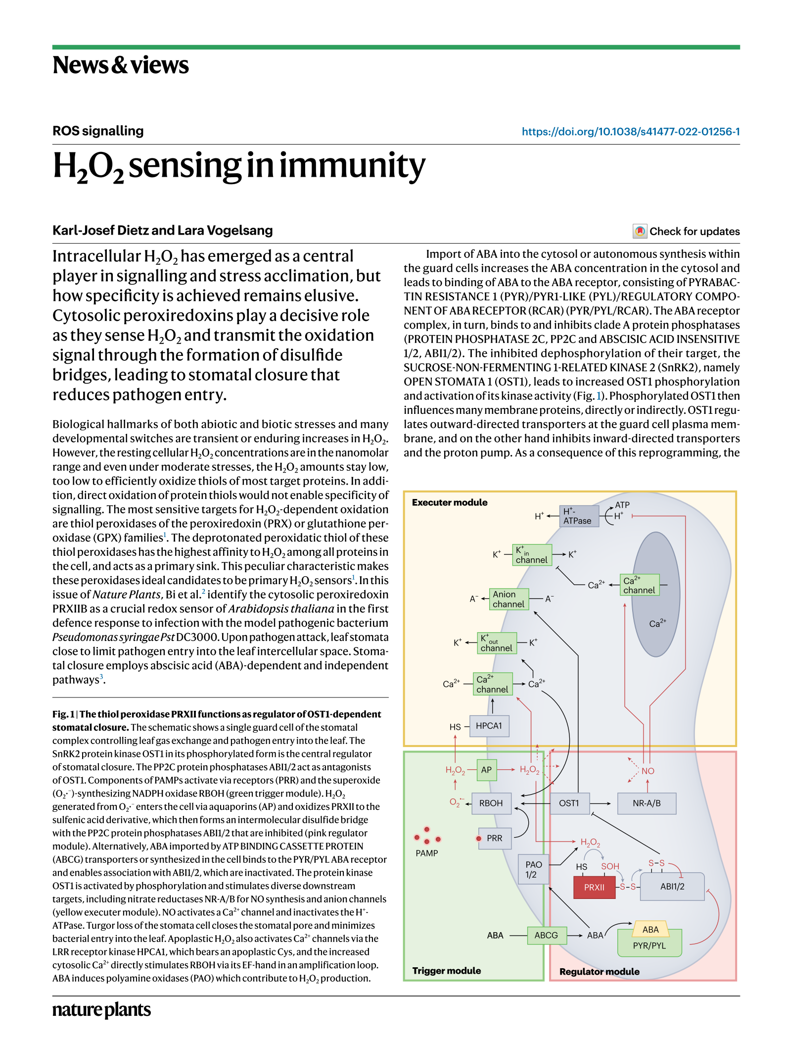
A redox relay to mediate redox signaling during plant immunity

Slide 34
Applications of our approaches
Mining for Cys-mediated redox sensors or regulators
Expanding the ligandable space in the Cys redoxome
Nat Plants 2022
Nat Commun 2021
Nat Cell Biol 2020
PNAS 2019
PNAS 2018
Redox Biol 2021
Nat Chem Biol 2023
Chem Sci 2021
Cell Host Microbe 2020
Cell Chem Biol 2017
Chem Res Toxicol 2017
Mol Cell Proteomics 2017

Slide 35
Conclusions
Why?
To address major technical challenges in analyzing cysteine redox changes at the proteome-wide scale
How?
To harness pChem to facilitate the development of chemoproteomic probes
So what?
To better understand cysteine-mediated redox regulation of protein functions and to expand the ligandable/druggable space in the cysteine redoxome

Slide 36
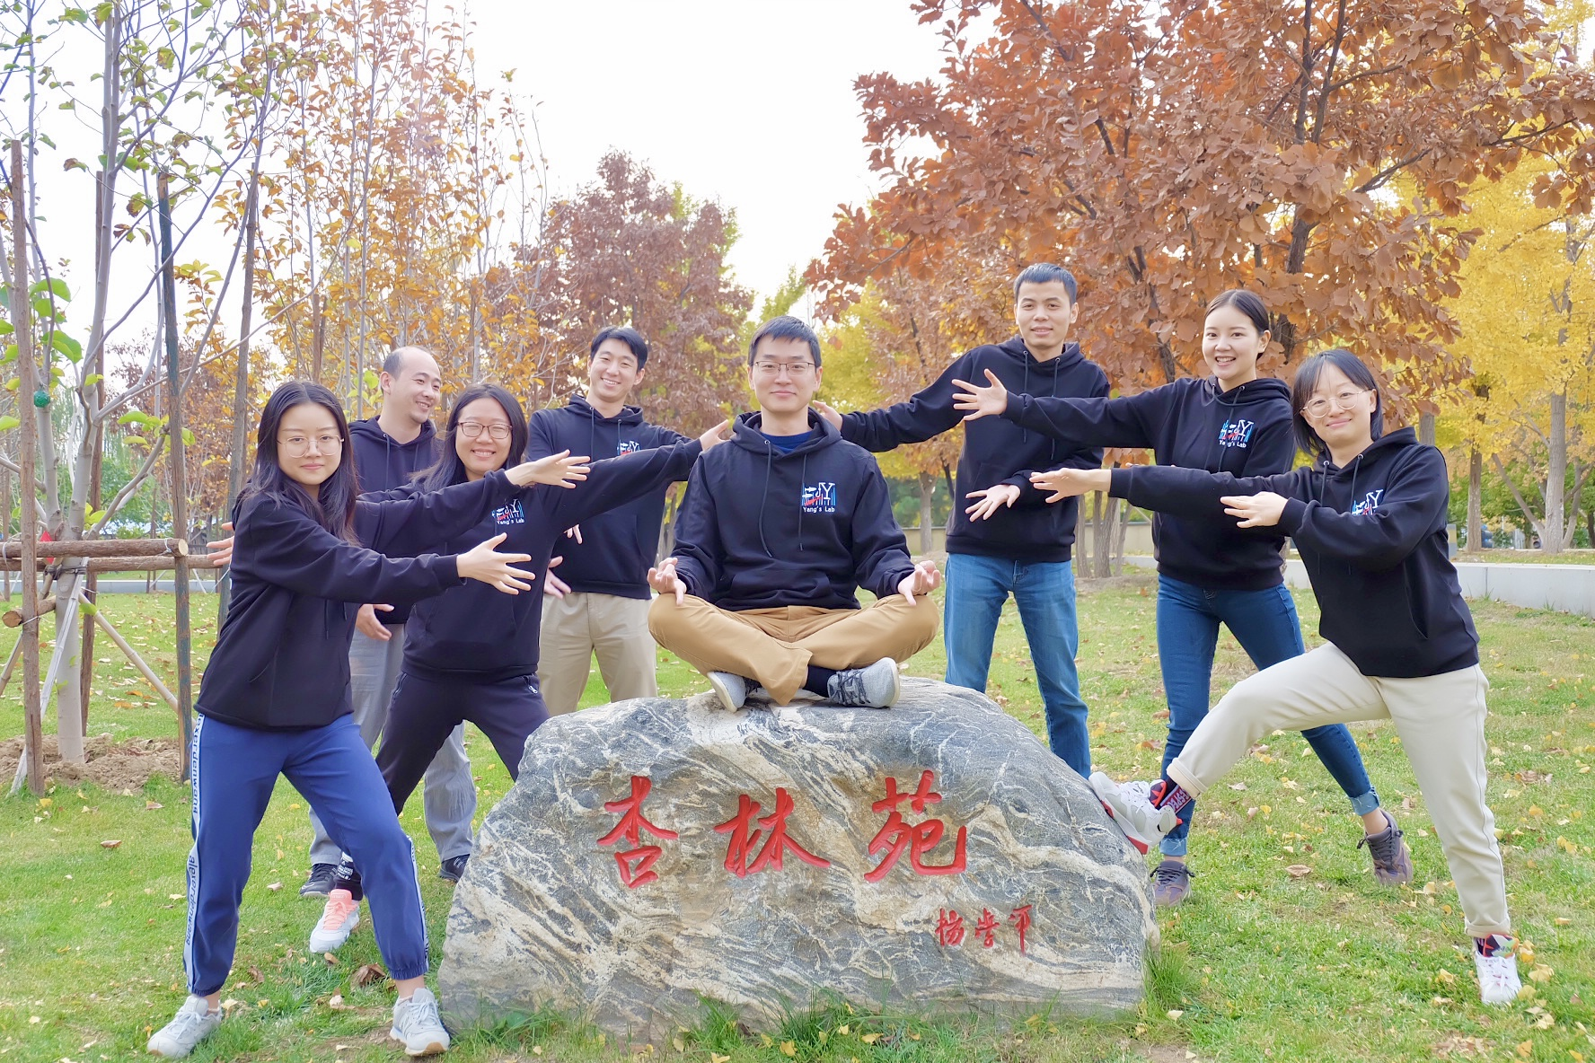




Acknowledgements
中科院计算所
迟浩 研究员
贺思敏 研究员
TSRI
Prof. Kate S. Carroll
中科院遗传所
周俭民 研究员
北京大学
金红芳 研究员
Whitehead, MIT
Prof. Terry Orr-Weaver
Harvard
Prof. Keith Blackwell
VIB
Prof. Joris Messens
Prof. Frank Van Breusegem
www.yangresearchlab.com
Twitter: @Yang_J_lab

